Slide 1

BANK PRODUCTS AND SERVICES

Slide 2

INTORDUCTION
Premier Bank is a privately owned Sharia-compliant commercial bank incorporated in Somalia in 2013 and licensed by the Central Bank of Somalia in 2014. We believe in the promise of a new Somalia. We all have a role to play in rebuilding Somalia. Together, we can make a difference. It is this philosophy that guides our efforts to help (in our own small way) rebuild Somalia and encourage economic and community development.
Our diverse knowledge of local financing requirements enables us to meet and service the needs of Somalia’s dynamic economy by introducing modern banking practices to the country. We offer comprehensive one-stop financial solutions to our customers who include private and government institutions, corporate and SME businesses as well as private individuals in Somalia.

Slide 3



MISSION, VISION AND CORE VALUE
To provide transformative and accessible financial solutions through excellent services for a better society
To Be The Best Bank That Customers Will Ever Want

Slide 4

MISSION, VISION AND CORE VALUE
People First We build relationships. We are professional. We offer excellent service.
Integrity We are trustworthy and behave in an open, honest and ethical manner with consideration of the impact and consequences of our decisions and actions
Accountability We take responsibility for our decision, action and our performance. We efficiently plan and perform work in accordance with business requirements, adhering to sharia principles and international banking standards. We use our resources appropriately to accomplish business objectives.
Partnership We are committed to partnering with all stakeholders. In this partnership, we seek new, innovative, and efficient ways of profitably meeting the need of all stakeholders
Customer Centricity We understand who the customer is and are willing and able to deliver hight quality services, which meets the needs and exceeds the expectation of all customers. We constantly strive to find new ways to increase customer satisfaction .

Slide 5
BANK PRODUCTS AND SERVICES
ACCOUNTS
CARDS
SWIFT
Internet Banking
Payroll
INVESTMENT AND FINANCING
Delivery Channels
WALLET
Wearables
Payment gateways

Slide 6
ACCOUNTS TYPES
Personal Current Account
Student Account
Personal Saving Account
Personal Salary Account
Requirements
Copy of Valid Passport / Valid National ID / Birth certificate / Regional Government ID / Valid Driving license
Valid Employment ID
Passport size photo
Contact and Address information
Requirements
1.Copy of Valid Passport / Valid National ID / Birth certification / Regional Government ID / Valid Driving license
2.Valid student ID.
3.Passport size photo
4.Contact and Address information
Requirements
Copy of Valid Passport / Valid National ID / Birth certificate / Regional Government ID / Valid Driving license
Valid Employment ID
Passport size photo
Contact and Address information
1.Copy of Valid Passport / Valid National ID / Birth certificate / Regional Government ID / Valid Driving license
2.Valid Employment ID
3.Passport size photo
4.Contact and Address information

Slide 7
ACCOUNTS TYPES
Joint Account
Hajj/Umra Account
Maandeeq Account
Business Current Account
Requirements
1.Copy of Valid Passport / Valid National ID / Birth certification / Regional Government ID / Valid Driving license for all individuals.
2.Passport size photo
3.Contact and address information
4.Request letter stating account operating mandate and Purpose of the account.
5.Minimum 2 individuals, maximum 5 individuals.
1.Copy of Valid Passport / Valid National ID / Birth certificate / Regional Government ID / Valid Driving license
2.Valid Employment ID
3.Passport size photo
4.Contact and Address information
1.Applicable only for women
2.Copy of Valid Passport / Valid National ID / Birth certificate / Regional Government ID / Valid Driving license
3.Valid Employment ID
4.Passport size photo
5.Contact and Address information
1.Copy of Valid certificate of registration
2.Notarized memorandum or articles of association
3.Copy of Valid Passport / Valid National ID / Birth certificate / Regional Government ID / Valid Driving license for Business owners and account signatories.
4.Request letter indicating resolution to open account and signing mandates.
5.Account signatories Passport size photo
6.Business contact and address information
7.Company profile

Slide 8
ACCOUNTS TYPES
Umma Account ( NGOs, Trusts, Charities, Education sector)
Business Sole-proprietor Account
Corporate Account
Requirements
1.Copy of Valid certificate of registration
2.Notarized memorandum or Article of association/ Constitution.
3.Copy of Valid Passport / Valid National ID / Birth certificate / Regional Government ID / Valid Driving license for directors and account authorized signatories
4.Request letter indicating resolution to open account and signing mandates.
5.Account signatories Passport size photo
6.Organization profile
7.Declaration of source of income
Requirements
1.Copy of valid business certificate
2.Copy of Valid Passport / Valid National ID / Birth certification / Regional Government ID / Valid Driving license for Business owner and account signatory
3.Request letter indicating resolution to open account and signing mandates
4.Account signatories Passport size photo
5.Address and contact information
Requirements
1.Copy of Valid certificate of registration
2.Notarized memorandum or Article of association
3.Copy of Valid Passport / Valid National ID / Birth certificate / Regional Government ID / Valid Driving license for directors and account authorized signatories
4.Request letter indicating resolution to open account and signing mandates.
5.Account signatories Passport size photo
6.Company profile

Slide 9
CARDS
Premier Mastercard is a secure tool in payment via Internet/POS and cash withdrawal via ATM worldwide.
Premier Mastercard is a secure card which designed with the high-end layer of security and provides security for customers using their banking services.
You can conveniently use Premier Mastercard to make withdrawals through any ATM and payments via any POS throughout Somalia and around the world where Mastercard’s logo is displayed.

Slide 10
Benefits
Making payments via POS terminals at any supermarkets, hotels, companies, etc. in Somalia or abroad where the Mastercard logo is displayed.
Pay for goods or services conveniently.
Making withdrawals quickly via all ATMs where the Mastercard logo is displayed throughout Somalia and around the world anytime.
Conveniently pay for goods or services, booking air tickets or hotel rooms, etc., over the internet.
Safety and convenience by not having to carry money.
Possibility of operating transactions anywhere worldwide with valuable consumer protections under the law.
Efficiency time and safety for cash management and settlements.

Slide 11
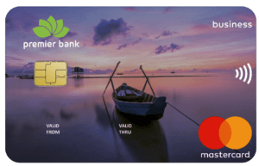
CARD TYPES
Corporate Mastercard
Premier Corporate Card is suitable for medium-sized and large companies with more complex expenses structures and higher demands in terms of reporting.
Corporate cards are a modern and secure means of payment. There are plenty of reasons to pay for your daily business expenditure using a corporate card
The Corporate card limit is $3000

Slide 12
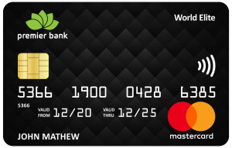
CARD TYPES
World Elite Mastercard
Premier Bank World Elite Mastercard credit card is the gateway to a world of unique experiences and services. It is truly a card that enables you to get what you want, when you want, at home, or when traveling.
Exclusive privileges are availed with the premier World Elite Mastercard. From loyalty program upgrades and global lounge access to exclusive privileges at luxury accommodations and VIP shopping experiences.
The World Elite card limit is $5000

Slide 13

CARD TYPES
Platinum Mastercard
Platinum Mastercard is a secure tool in payment via Internet/POS and cash withdrawal via ATM worldwide.
You can conveniently use Premier Mastercard to make withdrawals through any ATM and payments via any POS throughout Somalia and around the world where the Mastercard’s logo is displayed.
The Platinum card limit is $2000

Slide 14
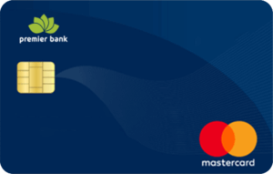
CARD TYPES
Classic Mastercard
Classic Mastercard is a secure tool in payment via Internet/POS and cash withdrawal via ATM worldwide.
You can conveniently use Premier Mastercard to make withdrawals through any ATM and payments via any POS throughout Somalia and around the world where the MasterCard’s logo is displayed
The classic card limit is $2000

Slide 15

SWIFT SERVICE
Our SWIFT offering provides a convenient channel that enables international money remittance and payments worldwide through banks. Money transfer across banks is safe, fast, and guaranteed through Premier Bank’s SWIFT service.
We are capable of receiving and sending from all nations.
Premier Bank's Swift Code: PBSMSOSM

Slide 16
INTERNET BANKING
What is Internet Banking?
is an electronic system managed by banks which enables customers to access financial as well as non-financial banking products online, also known as Online Banking.
Features of Internet Banking
A secure and convenient method of banking
Password-protected banking system
Easy access to financial and non-financial banking products/services
Access your bank account anytime anywhere
Track and manage bank balance, last transactions, statements, etc
Transfer funds online via NEFT, RTGS, IMPS anytime
Keep a track of payments, personal loans, home loans, business loans, credit cards, savings account, etc.
Channelize or cancel automatic payments such as Standing Orders

Slide 17
INTERNET BANKING
How to register Internet Banking ?
You can submit the Internet Banking Application Form at the branch along with required documents such as a copy of your bank passport.
The bank will verify all the information and then issue a customer ID and password for internet banking
The Internet Banking application can be register from the bank’s official website
After receiving the credentials, you can log-in and access Internet Banking

Slide 18

PAYROLL PROCESSING
Our payroll processing system saves you all the time and resources required to manage your salary and wages payments. Let Premier Bank help you with your payroll processing so that you can focus on the more important things.
Simply open a salary current account for your employees and let us do the rest. At the click of a button, our system will credit all your employees’ accounts and send an SMS notification to each one of them.
Premier Bank payroll processing ensures that your employees receive their salaries on time and save your company time and money

Slide 19
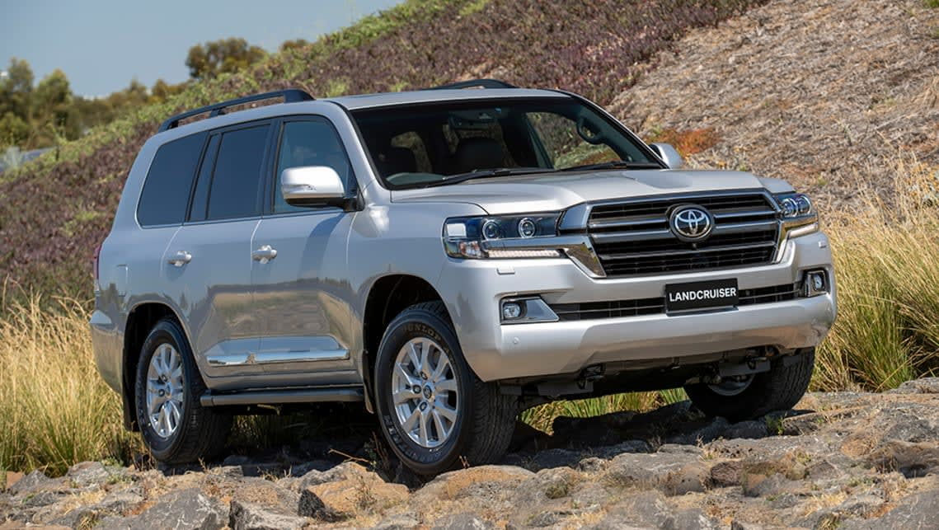
INVESTMENT AND FINANCING
AUTO FINANCE:
A flexible and affordable financial solution that gives you access to your dream car.
Our Auto Finance product is a tailor-made facility for salaried or self-employed individuals who want to purchase new or used cars for private use.
Key Features & Benefits
Free financial planning and expert advice
Up to 24 months repayment period
Finance both new and used cars;
Financing from as low as USD 3,000
Affordable monthly instalments
Competitive profit rates
Sharia-compliant

Slide 20

INVESTMENT AND FINANCING
Land Construction Finance
A financial solution that enables individuals to acquire undeveloped land for construction purposes.
Our Land Finance product is a simple but practical facility designed to support ambitious individuals who want to get into construction but have limited funds to acquire land for development.
Key Features & Benefits
Free financial planning and expert advice
Repayment period of up to 36 months
Competitive profit rates
Sharia-compliant
Requirements
Guarantee letter or property collateral;
Copy of Title Deed and other ownership documents of the property being purchased
Proof of 30% down payment
Letter of introduction from employer (if employed)
Certified bank statements for the last 6 months
Copy of ID/Passport and 3 passport size photos

Slide 21

INVESTMENT AND FINANCING
Business Trade Financing
We offer long, medium, and short term financing for business expansion and acquisition of commercial property. This facility is ideal for businesses that require extra funds on an ongoing basis to enable them to meet and satisfy their trading requirements.
Financing Options Include:
Letters of Credit
Shipping Guarantees
Bank Guarantees
Import Financing
Invoice Financing

Slide 22
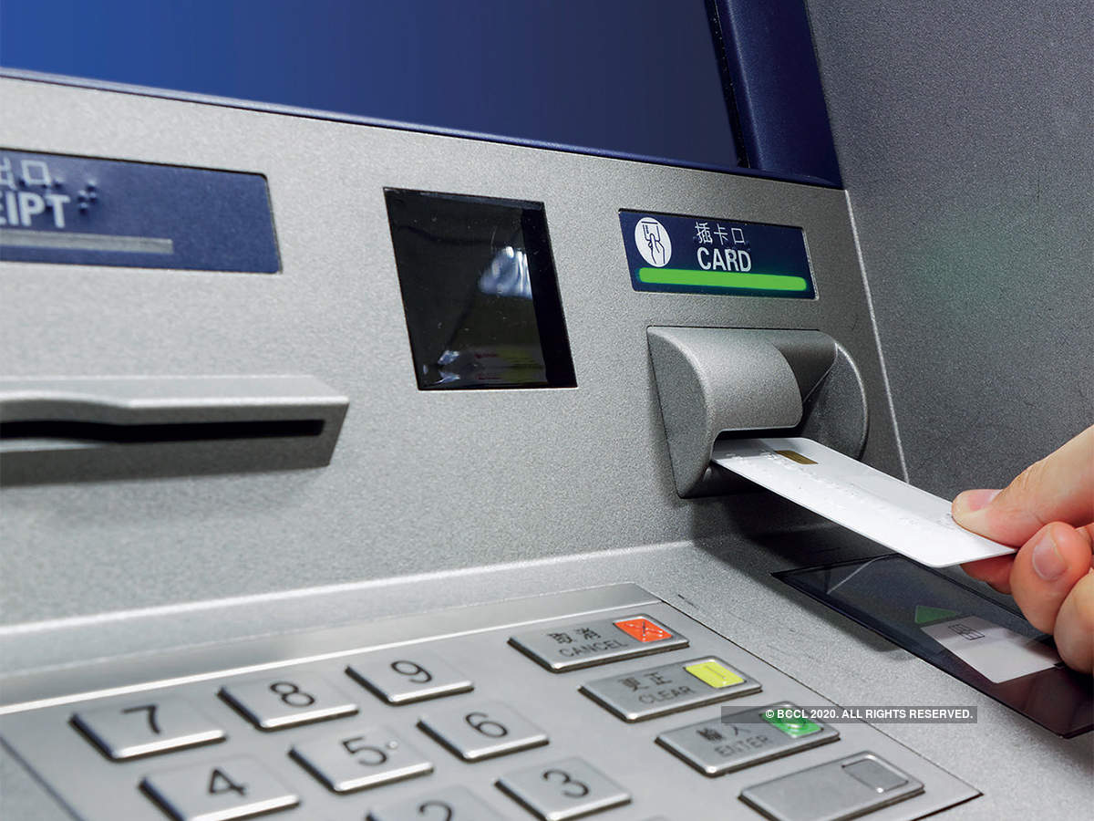
ATM
What is ATM?
ATM An automated teller machine that allows you to complete bank transactions without the need to see a bank representative
Your Premier Bank ATM card provides quick and easy access to your bank account and funds 24 hours a day, 7 days a week. Access your money in-person, online, and use your card to withdrawal cash from any ATM around the world. It’s not a credit card, but for safety and convenience.
The Larges ATM Network In Somalia

Slide 23
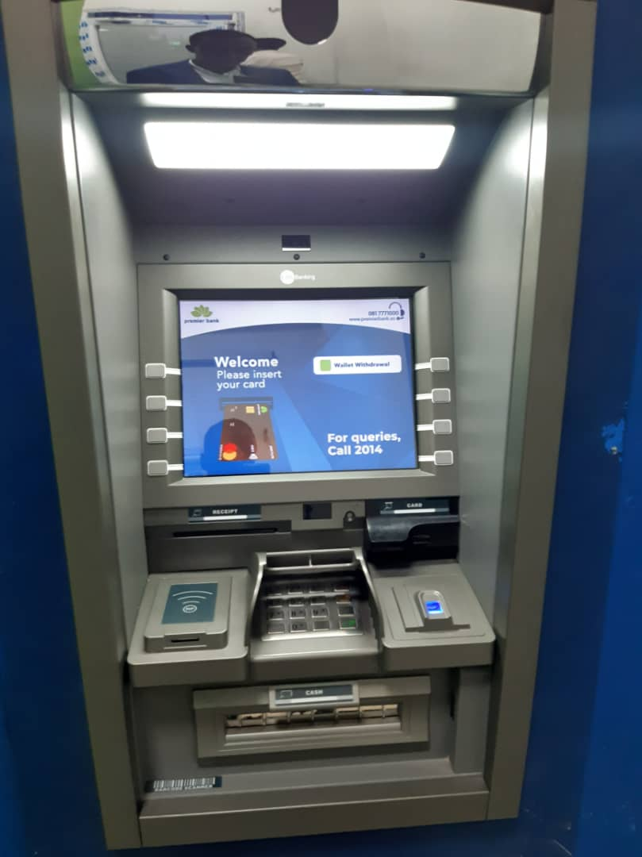
ATM
ATM services/Features:
Cash withdrawal
Balance inquiry
Mini-statement
Cardless Withdrawal ( Wallet)
And more

Slide 24
Premier Bank ATM Convenient Locations
Supermarkets
Airports
Retailers
Malls
Hotels
All Branches
Regions

Slide 25
PB ATM TERMINAL LOCATIONS MOG & REGIONS
Total ATMs 30
Regions 9
Mogadishu 21

Slide 26
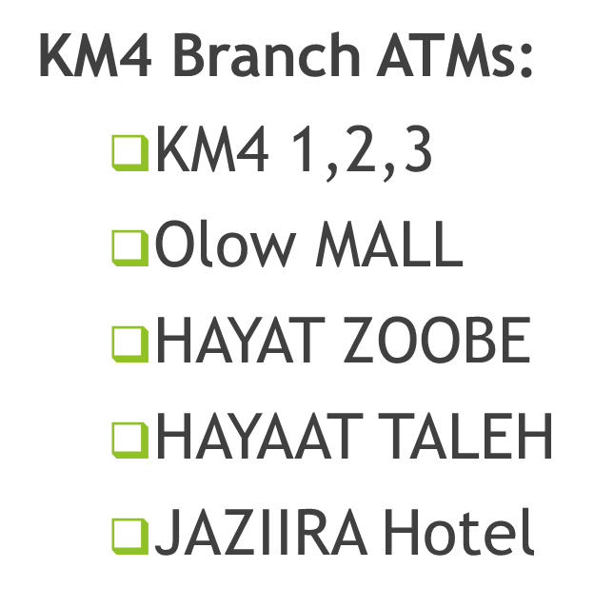
PB ATM TERMINAL LOCATIONS MOG & REGIONS

Slide 27
PB ATM TERMINAL LOCATIONS MOG & REGIONS
Airport Branch ATMs:
Branch ATM
Int. arrival
Decale
AC Camp
Star Empire
SKA

Slide 28
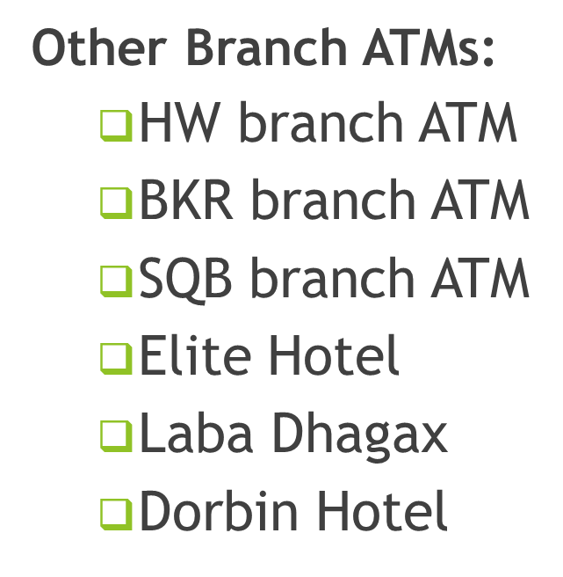
PB ATM TERMINAL LOCATIONS MOG & REGIONS

Slide 29
PB ATM TERMINAL LOCATIONS MOG & REGIONS
Regional ATMs:
Baidoa 1 & 2
Kismayo
Dhusamareb
Garowe 1&2
Galkacyo
Qardho
Bosaso

Slide 30
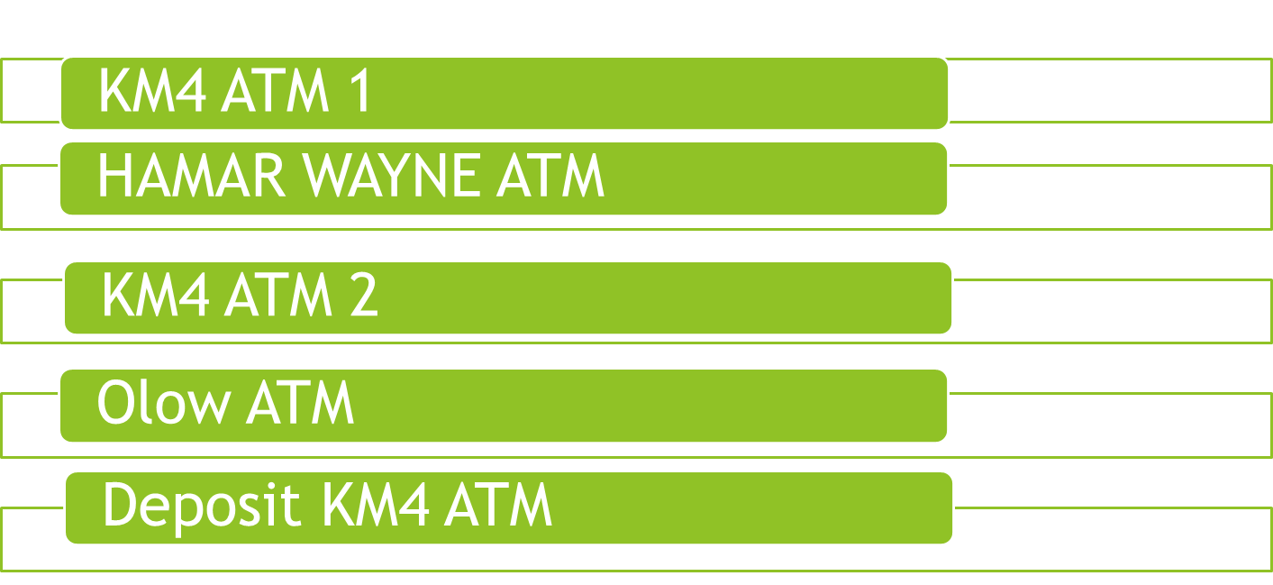
TOP FIVE PERFORMING ATMS

Slide 31
BOTTOM FIVE UNDERPERFORMING ATMS
ELITE ATM
GAROWE BRANCH ATM
DHUSAMAREB ATM
GALKACYO ATM
INTERNATIONAL ATM

Slide 32
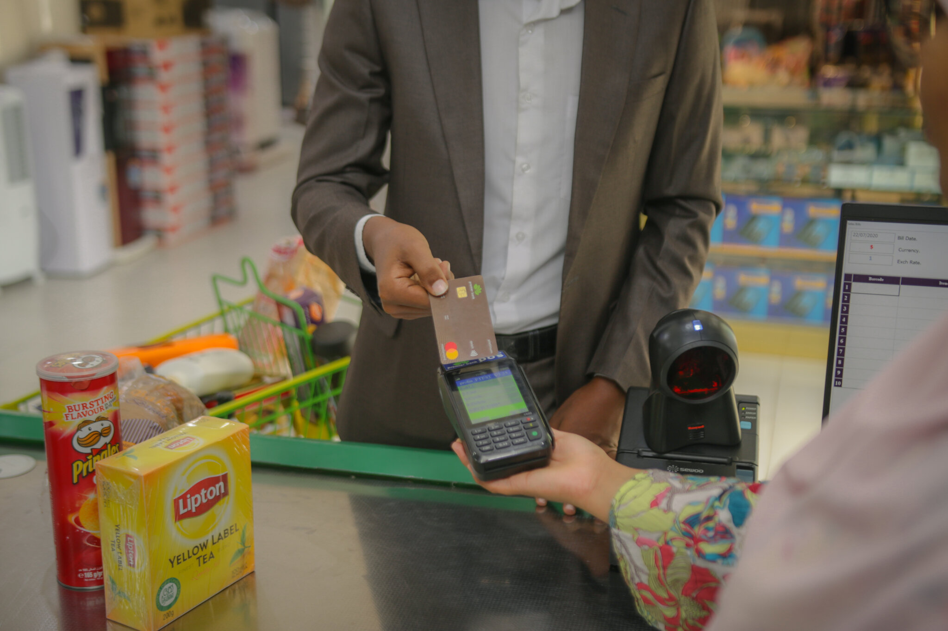
Premier POS
What is the Premier POS?
Premier POS is an electronic payment processing machine that eliminates the need for cash. Process payments safely and conveniently with:
Premier MasterCard Debit Card
Other bank cards: VISA, MasterCard, and Discover
Advantages
No cash required
Safe and convenient payment processing
Discounts and promotions from our partners
Where to Use
You can use Premier POS in many locations in all provinces and towns including:
supermarkets, shopping centres, clothing shops, travel agencies, universities, hotels, gas stations, hospitals, and more.

Slide 33
PB POS TERMINAL LOCATIONS MOG
Airport POS:
Decale
Es-ko International
Chealse Village
Airport Hotel
Star Empire
Peace Business Group
DFS and Center Point Supermarket
CIP LOUNGES And AVEN PREMIER INTERNATIONAL (API) IWM

Slide 34
PB POS TERMINAL LOCATIONS MOG
Other areas POS:
Midnimo
Hayat
Carwo Hal door
Aaran Supermarket
IDAN FRAGRANCES
AMB EXECUTIVE STORE
STAR MACANI SHOPING
HOTEL DOORPIN
BEYDAN and Bin AArif

Slide 35
PB POS TERMINAL LOCATIONS MOG
Total: 319
Regions 32
Mogadishu 287

Slide 36

AGENCY BANKING
You can still access Premier Bank if you live in a remote area that doesn’t have a branch nearby. We have Authorized Premier Agents placed in strategic locations throughout Somalia.
Authorized Agent Services
Our authorized Agents process a variety of essential banking transactions quickly, easily, and conveniently. Services include:
Open New Accounts
Check Your Balance
Cash Deposits
Cash Withdrawals
Transfer Funds
Many of these same services can also be performed at a nearby Premier Bank ATM.

Slide 37
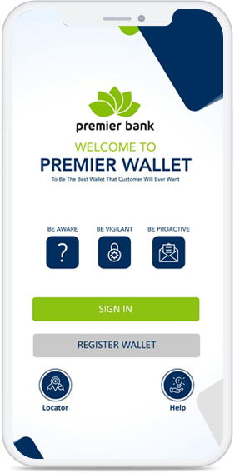
Premier Wallet
Enjoy Amazing Features Benefits
Premier Wallet is the most successful mobile money service in Somalia.
Premier Wallet offers financial services to non-banked populations
or people with limited access to banks. Premier Wallet is a safe,
affordable, and secure way to trade on your smartphone.
Top-up, money transfer, withdrawals, bill payments, and mobile banking
are the primary features of Premier Wallet.

Slide 38

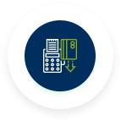




Premier Wallet
Amazing Feature
Everything on premier wallet is blazing fast. You can onboard in minutes, pay your friends, bills, or merchants in one tap. Your personal and financial data is encrypted and saved on our secure servers. Your money is safe with us.
Transferee
Top Up
Withdrawal
Bill Payment
Mobile Banking
Wallet Send

Slide 39
WALLET SEND AND REMITTANCE METHODS
Mobile Money
Cash Pickup
Bank Transfer

Slide 40
WALLET SEND AND REMITTANCE COUNTRIES
More than 101 countries

Slide 41
Wearables
Wearables: Definition
What Are Wearables?
Definition: Wearables are portable, electronic devices designed to be worn on the body. They often integrate sensors, communication modules, and now, payment technologies like NFC(Near Field Communication).

Slide 42
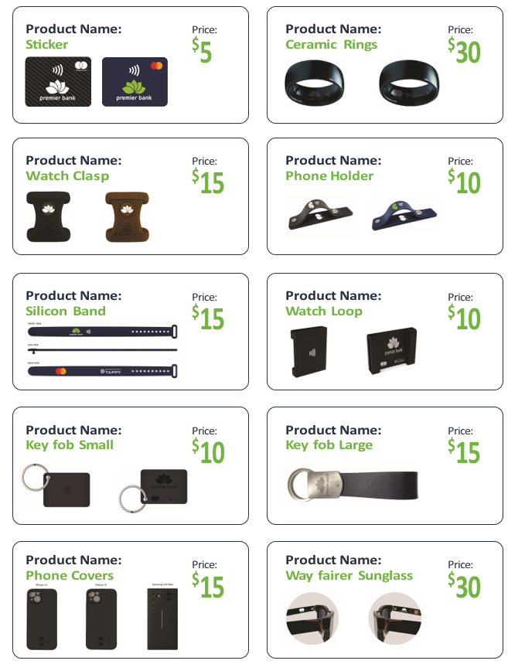
Wearable Products
Tap2Pay Wearables

Slide 43
Payment Gateways
Overview of (Mastercard Payment Gateway Services ) MPGS
What Is MPGS?
Global payment processing platform
Operates in over 170 countries
Supports +200 acquire connections
Processes Billion of transactions annually
Serves: Fraud prevention, PCI compliance, Multi payment methods
Hight uptime, multi language, muti Currence support

Slide 44

Q&A

Slide 45

Thank You!
www.premierbank.so

